Slide 1
The maintenance industry’s commitment to the UN Sustainable Development
Notes:
SDG Tiles 3 and 4 are relevant for a connection to HSElife - Q

Slide 2
The maintenance industry’s commitment to the UN Sustainable Development
17. Partnerships for the goals
15. Life on land
3. Good Health and well- being
14. Life below water
4. Quality Education
13. Climate Action
6. Clean water and
sanitation
12. Responsible consumption and production
9. Industry, Innovation and Infrastructure
Notes:
Tiles need to be discussed with Jan Teun.

Slide 3
Maintenance excellence supports UN Global sustainability goals
Topics to be addressed.
0) Asset Life time extension.
Predictive maintenance – Workforce culture - Circularity
1) Energy efficiency optimization.
Combustion systems – Heat exchangers – Steam heating systems. Etc.
2) Improving environmental parameters.
Permit requirements goals - Reduction of water use – Effluent systems
3) Supporting Bio diversity.
Relationship with external partners – Supporting society -
Notes:
Predictive maintenance activities according new Industry 4.0 principles.
Workforce culture; Activate a common company mindset to improve the UN SDG. Use the lessons learned for a common safety culture.
Circularity; Discuss with external stakeholders circularity.

Slide 4
Examples of UN Sustainable Development Goals
1.-SDG7: "Guarantee access to affordable, safe, sustainable and modern energy for all".
Among the contributions that this maintenance would have for this objective, is to minimize energy consumption.
2.-SDG9: "Build resilient infrastructures, promote inclusive and sustainable industrialization and foster innovation."
The contribution of this maintenance would be in addition to minimizing energy consumption, less waste and lengthening the useful life of physical assets.
3.-SDG12: "Guarantee sustainable consumption and production patterns".
Greater data reliability would be the contribution of this maintenance, in addition to less energy consumption and less waste.
4.-SDG17: ” Partnerships for the goals.
It’s essential that authorities , asset owners ,equipment suppliers, design contractors and service providers share their knowledge in the same way the industry is working together as in all HSE related matters.

Slide 5
SDG -7 Equipment Energy efficiency optimization.
Combustion systems – Heat exchangers – Steam heating systems. Etc.
a) Combustion system; Optimum energy efficiency and reduction of air pollution. ( Burner efficiency , Low O2 in exhaust gases , heat transfer optimization, reducing dust and toxic components.
b) Heat exchangers. Optimize tube cleaning interval & cleaning , reduce cooling medium flow , monitor water cooling effluent temp effects. (Biological impact) etc.
SDG – 6-15 Improving environmental parameters.
Permit requirements goals - Reduction of water use – Effluent systems.
Improve environmental permit targets – water containment and circularity -
Separate polluted systems from rain and clean process water – prevent soil pollution by active civil maintenance etc.
Notes:
Ad2 Questions; Who is informed about environmental asset permit requirements. - Who is involved in reporting of these requirements.
Do you manage these data in your work management system? Do you have a process in place to improve environmental targets.
Do you have a soil/water pollution measuring system in place. Do you have a civil maintenance plan in place for liquid tide floors , drain systems, bund walls and drain pits?

Slide 6
SDG 14-15 ) Supporting Biodiversity.
Relationship with external partners – Supporting society -
Statement: Improving global and companies sustainable goals are not possible without interaction between government and external stakeholders. Therefore management and staff should interact with organizations with knowledge of Biodiversity and all related matters with impact on the environment.
An environmental and social impact assessment is an instrument for a responsible company to inventories ,validate and improve its footprint.
Maintaining assets mean also maintaining the conservation of natural systems with an intelligent long term strategic vision.
Notes:
Examples of improving biodiversity on and around industrial areas together with external stakeholders.
Birth nests; Falcon nests on high installations. Shore swallows in verticular walls. A specific mowing policy for bird nests and butterflies etc.
A fire water pond with facilities for reptiles and water birds. Rainwater collection for the improvement of groundwater levels.
The reduction of light during dark hours to support animal wildlife. (Example offshore platforms with greenlight)

Slide 7
Examples of improving biodiversity on and around industrial areas in cooperation with external stakeholders.
Birth nests; Falcon nests on high installations. Shore swallows in verticular walls. A specific mowing policy for bird nests and butterflies etc.
A fire water pond with facilities for reptiles and water birds. Rainwater collection for the improvement of groundwater levels.
The reduction of light during dark hours to support animal wildlife. (Example offshore platforms with greenlight)

Slide 8
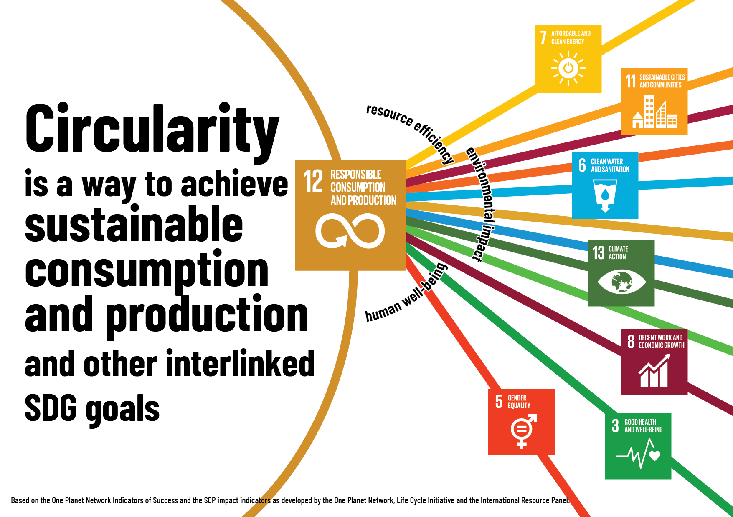
Notes:
Viewgraph is an example to connect UN SDG to Circularity.
These tiles are all related to maintenance activities.

